Slide 1
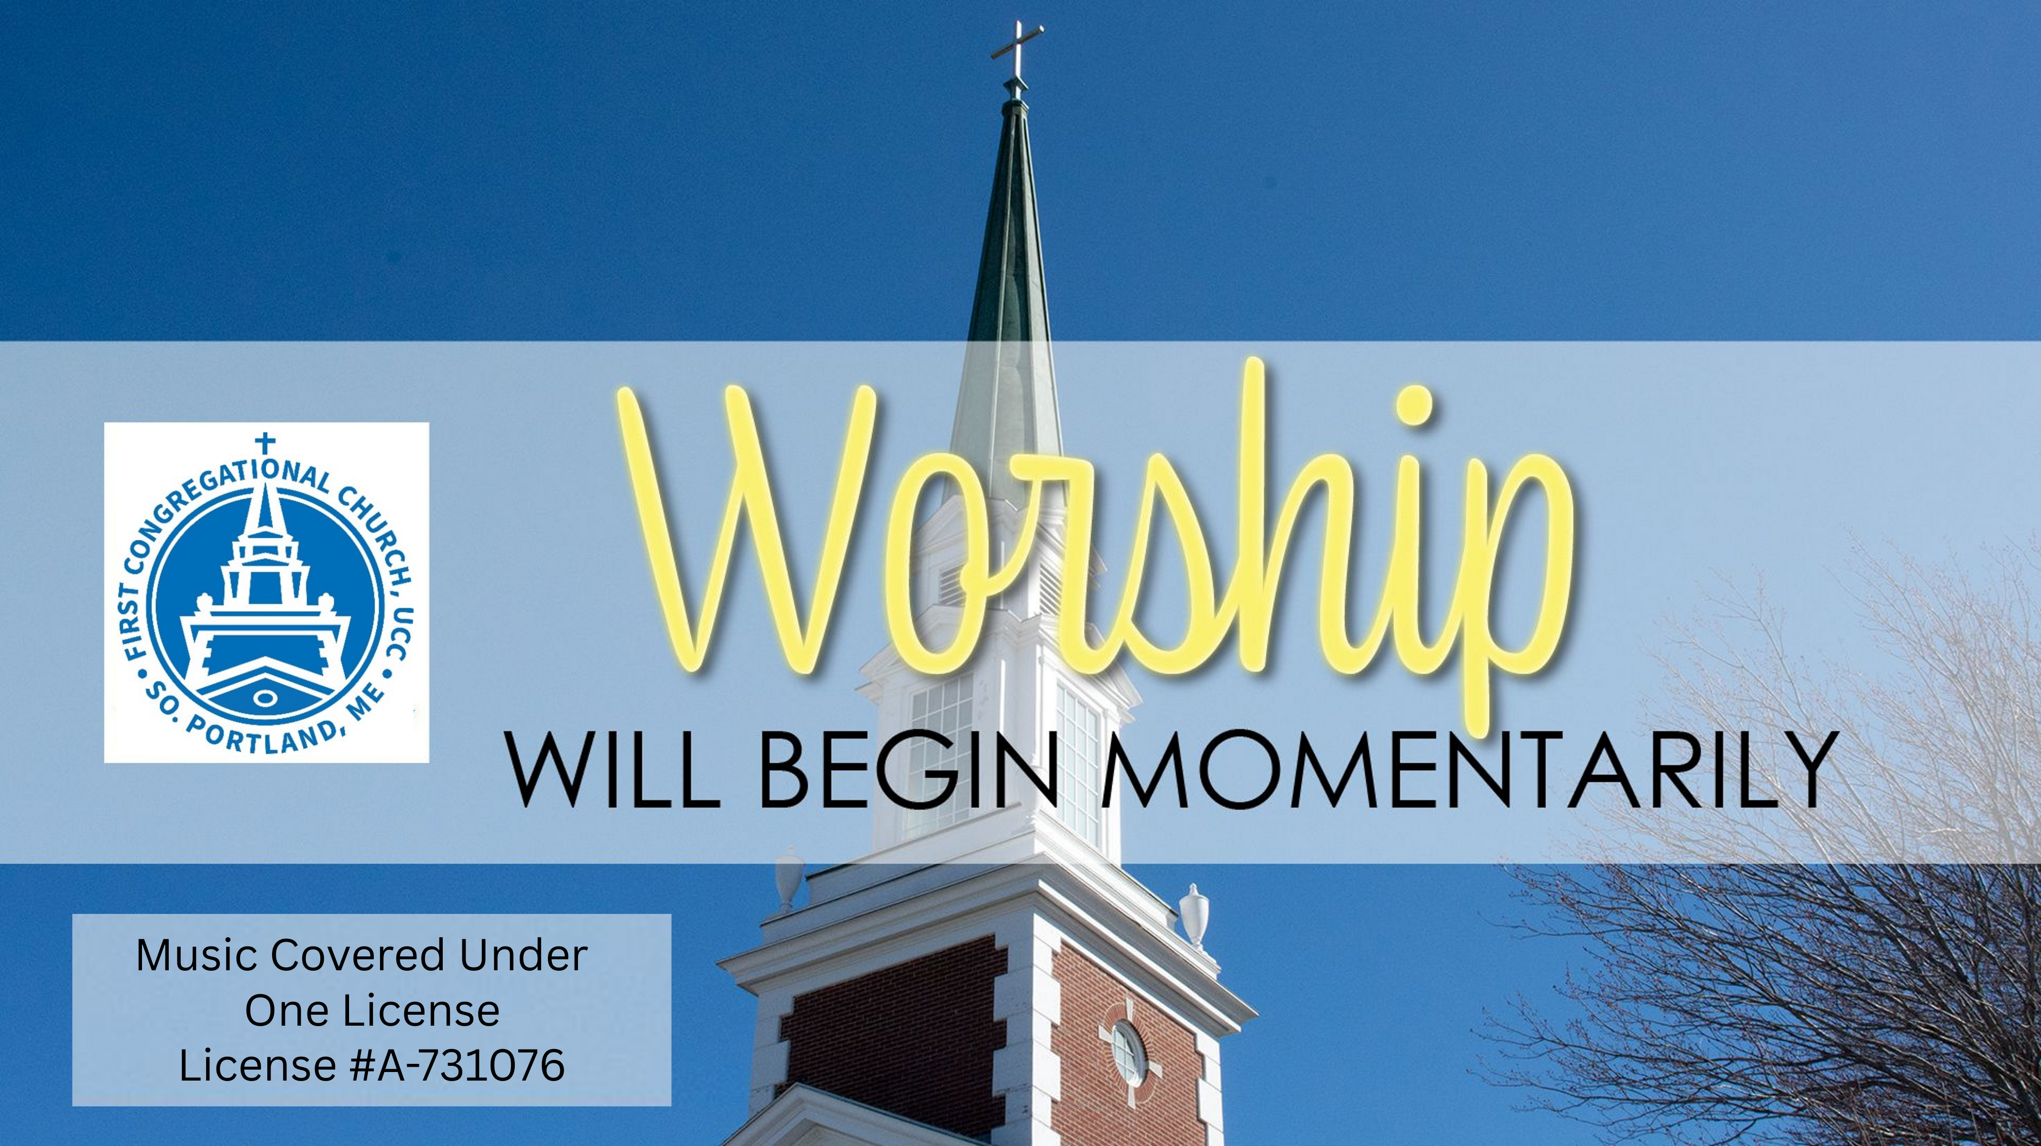

Slide 2
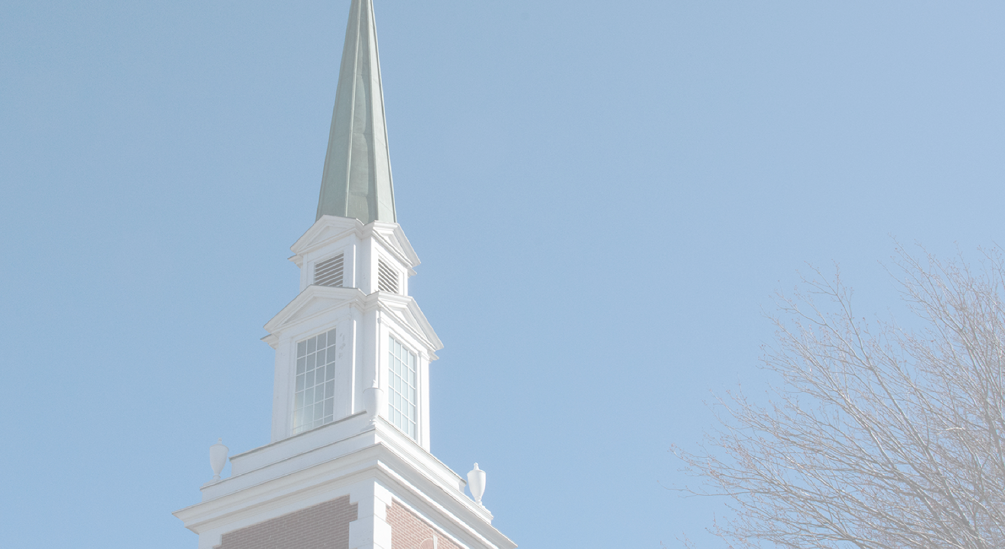
COPYRIGHT INFORMATION
Music used in worship covered under the following One License, copyright license # A-731076
My Lord What a Morning
African American Spiritual, arr.John Behnke
One License #93602
When Jesus Came Preaching
Fred Pratt Green
One License #01144
We’ll Build A Land
Carolyn McDade
One License #127299
Guide My Feet
African American Spiritual
Public Domain
Weave
Rosemary Crow
Permission granted
Believe Your Eyes
Thomas Keesecker
Permission Granted
Dream God’s Dream
Brian Sirchio
One License #62539
Nottorno, #4 from Lyric Pieces, op. 54
Edvard Grieg
Public Domain

Slide 3
STAY IN TOUCH
Subscribe to our Weekly Word:
Stay on top of FCC UCC news, events and volunteer opportunities!
The Weekly Word arrives in your email every Thursday morning.
Sign up or update your contact info at: fccucc.org. select “Contact Us” then “Contact Info Update Form.”

Slide 4



STAY IN TOUCH
Follow us, like and share on Social Media:
Facebook: facebook.com/fccucc
Instagram: instagram.com/fccucc_s.portland
YouTube channel:
youtube.com/@FCCUCCSouthPortland

Slide 5
CELEBRATE A LIFE OR OCCASION
Would you like to honor the memory of a loved one or celebrate a special person or occasion by placing flowers on the altar or lighting the Mission Globe? if so, please contact Danna Wiggins at dannawig2@gmail.com
To dedicate the lighting of the church steeple, please contact the church office at 799-3361 x or email office@fccucc.org.

Slide 6
VOLUNTEER
Seeking Volunteers for Preble Street
Food Hub: On the last Friday of each month, we prepare meals at the Food Hub, 75 Darling Ave. South Portland, for delivery to Preble Street satellite sites. Please join us! See the Weekly Word or contact Danna Wiggins at dannawig2@gmail.com with questions.

Slide 7
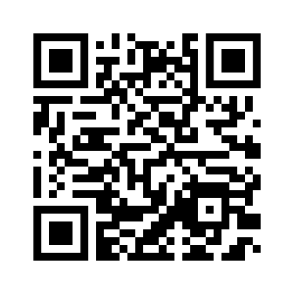
THIS MORNING’S BULLETIIN
Our worship bulletin is now available online.
Scan the QR Code for a digital version:

Slide 8
Welcome to Worship!
Lent Week 1:
“The Holy Work of Unwinding”
February 22, 2026

Slide 10
CALL TO WORSHIP
One: Welcome to all who have come in search of something;
All: We have come to seek the living God.
One: Happy are those who find a way and follow that path;

Slide 11
CALL TO WORSHIP
All: We do not make this journey by ourselves.
One: Blessed are those who embrace the search and welcome the mystery.
All: In curiosity, in trust, with hope, let us worship God.

Slide 13
BLESS NOW, O GOD, THE JOURNEY
Bless now, O God, the journey
That all your people make
The path through noise and silence
The way of give and take

Slide 14
BLESS NOW, O GOD, THE JOURNEY
The trail is found in desert
And winds the mountain round
Then leads beside still waters
The road where faith is found

Slide 15
BLESS NOW, O GOD, THE JOURNEY
Bless all of us, your pilgrims
Who share this winding way
Whose hope burns through the terrors
Whose love sustains the day

Slide 16
BLESS NOW, O GOD, THE JOURNEY
We yearn for holy freedom
While often we are bound
Together we are seeking
The road where faith is found

Slide 17
BLESS NOW, O GOD, THE JOURNEY
Divine eternal lover
You meet us on the road
We wait for lands of promise
Where milk and honey flow

Slide 18
BLESS NOW, O GOD, THE JOURNEY
But waiting not for places
You meet us all around
Our covenant is written
On roads, as faith is found.

Slide 20
PRAYER FOR FORGIVENESS
Mending, tending God: Your Word can be hard to unravel. Too often, your people wrap faith in divisive words and destructive ways, until the life you promise gets obscured under layers of shame and blame - inflicted not by You but by us, on each other. When we confuse faith with self-interest, forgive us. Help us to disentangle your will from ours; your love from our fear; your grace from our judging. Show us again how to uncover the Good News of your unwavering love.

Slide 22
PASSING OF THE PEACE
Pastor: The peace of Christ be with you.
People: And also with you. ✌️ ☮️ 👋

Slide 24
PRAYER FOR ILLUMINATION
One: Holy One, the story of Jesus’ life is complicated: a tangle of love and betrayal, hope and violence, pain and mystery.
All: Help us to unravel the Good News in this sacred text, to pull at the threads of love and justice, until we can knit together a liberating garment of healing and hope..

Slide 26
THE LORD’S PRAYER
Our Father-Mother in heaven, hallowed be thy name. Thy kin-dom come; thy will be done on earth as it is in heaven. Give us this day our daily bread, and forgive us our debts as we forgive our debtors. And lead us not into temptation but deliver us from evil, for thine is the kin-dom and the power and the glory forever. Amen.

Slide 28
RESTLESS WEAVER
Restless Weaver, ever spinning threads of justice and shalom;
dreaming patterns of creation where all creatures find a home;
gathering up life’s varied fibers - every texture, every hue:
grant us your creative vision. With us weave your world anew

Slide 29
RESTLESS WEAVER
Where earth’s fragile web is raveling help us mend each broken strand;
Bless our urgent, bold endeavors cleansing water, air, and land.
Through the Spirit’s inspiration - offering health where once was pain –
strengthen us to be the stewards of your world knit whole again.

Slide 30
RESTLESS WEAVER
When our violent lust for power ends in lives abused and torn,
from compassion’s sturdy fabric fashion hope and trust reborn.
Where injustice rules as tyrant, give us courage, God, to dare
live our dreams of transformation. Make our lives incarnate prayer.

Slide 31
RESTLESS WEAVER
Restless Weaver, still conceiving new life - now and yet to be –
binding all your vast creation in one living tapestry:
you have called us to be weavers. Let your love guide all we do.
With your Reign of Peace our pattern, we will weave your world anew.

Slide 33
No Matter Who You Are,
Or Where You Are On Life’s Journey,
You Are Welcome Here!
FCCUCC.ORG

